Slide 1
SpectreAI: From "Bot's Down" in Slack to a Draft PR in Under 2 Minutes
Your support channel just became a self-healing engine.

Slide 2


SpectreAI
Nithin BR
Agentic Architect @ Persistent Systems
nithin_b@persistent.com

Slide 3
Problem Statement & Proposed Solution
Problem
Solution
An end user messages the support channel: "Invoice bot crashed again."
Developer manually digs through Orchestrator logs across multiple folders
Figures out if it's a code bug or data issue, finds the exact failing line in XAML
Raises a PR — while the user waits with zero visibility
Every failure = hours of developer time + frustrated end users.
SpectreAI takes over the moment that Slack message lands.
Investigation Agent — 3-layer log fetch across Orchestrator folders
Triages issue type: credentials / timeout / business exc. / system error
Searches Spectre KB for past incidents, confidence-scored diagnosis
Coding Agent — discovers repo by process ID, selects candidate XAML files
LLM patches exact broken lines (line_range / multi_range / full_rewrite)
Validates XML, commits, opens labelled Draft PR
End user: live Slack updates throughout. Developer: PR lands in their channel.

Slide 4
Impact & What Makes SpectreAI Stand Out
Before | After SpectreAI
2-4 hours per fix | < 2 minutes
Developer on-call triages | AI agents triage
Manual log search, one folder | 3-layer parallel search across all
Best-guess issue routing | Auto-classified & routed by type
Full manual XAML edit | Surgical line-range patch only
Blank PR, no context | Labelled, classified, confidence-scored
User waits with no updates | Live Slack status throughout
Starts from zero each time | SpectreKB learns every diagnosis
One bot at a time | Any UiPath process in the org
Powered by: UiPath Maestro + Coded Agents | LLM Gateway (GPT-4.1 mini) | GitHub API + PyGithub | Slack + SpectreKB

Slide 5
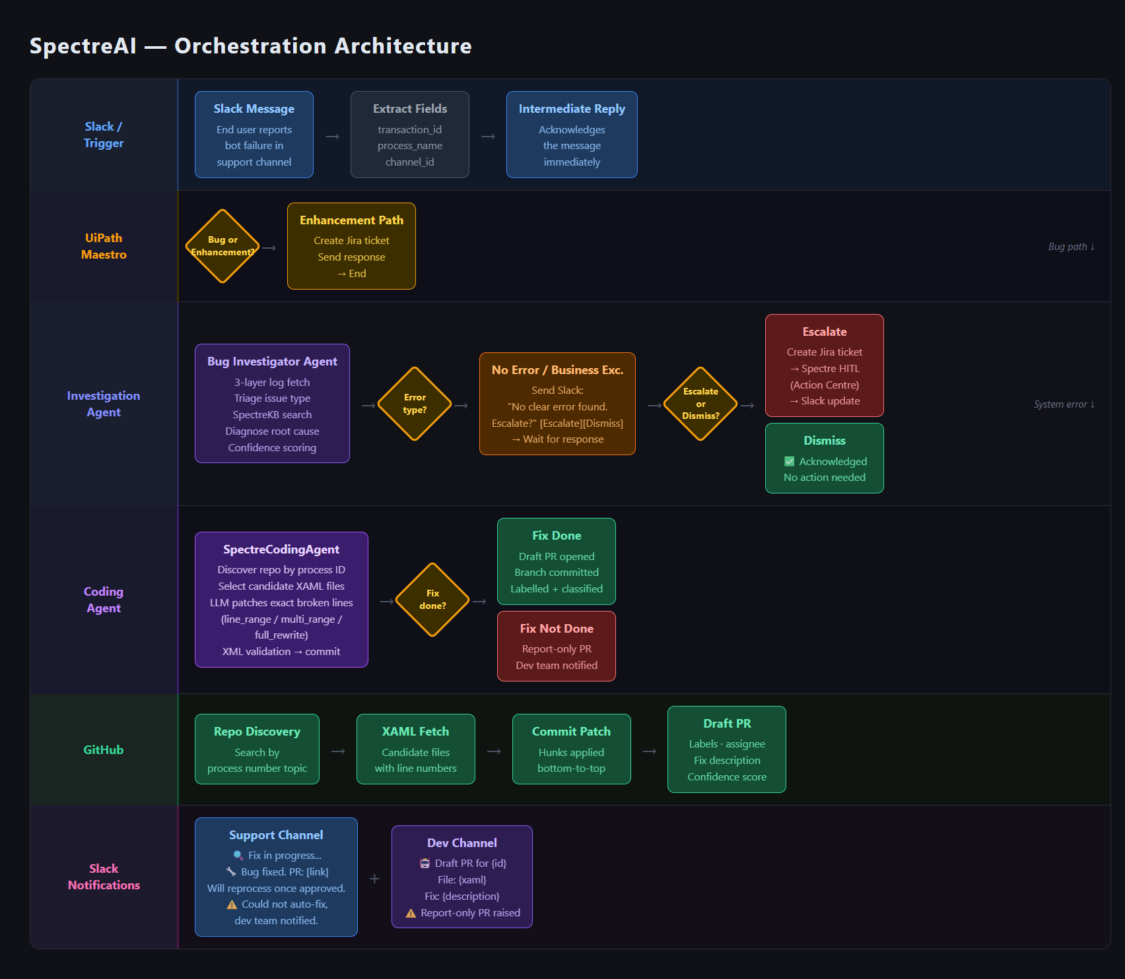
Solution Architecture

Slide 6
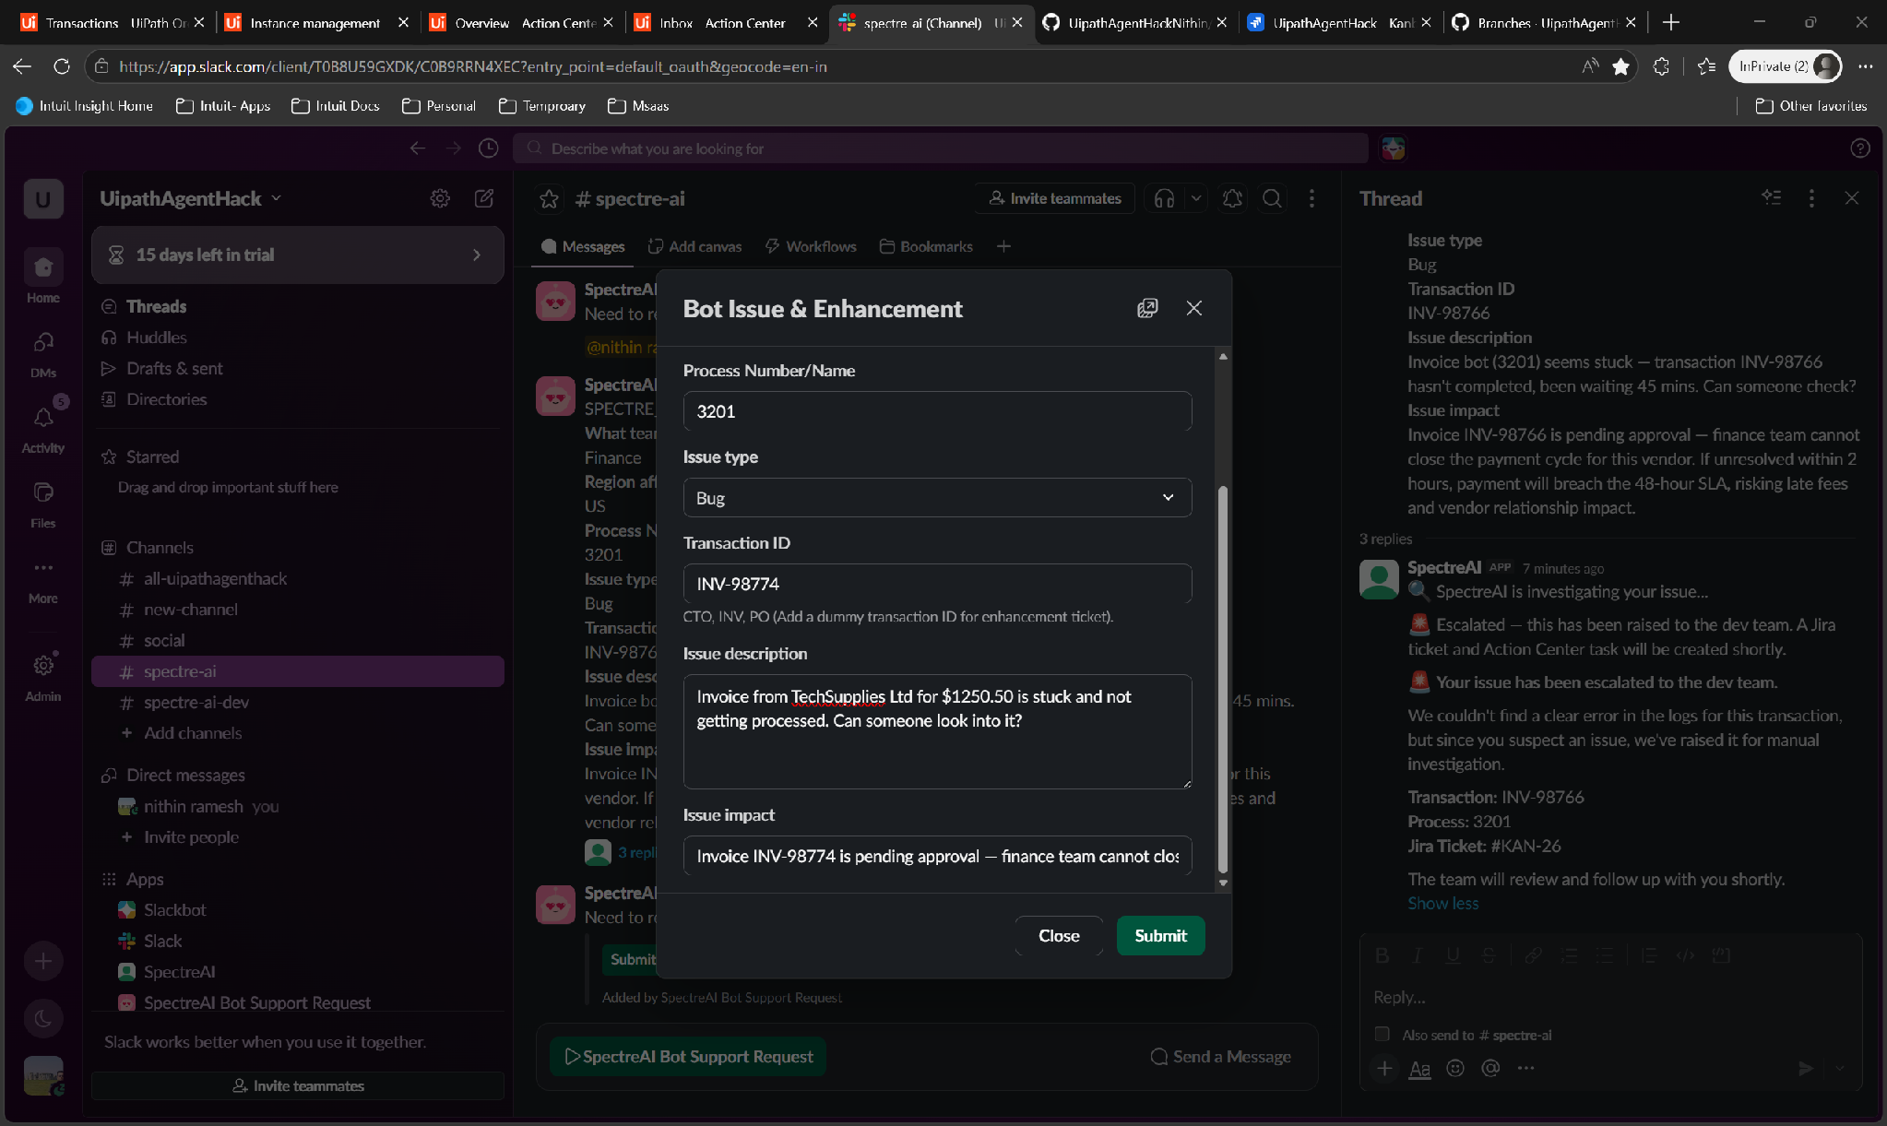
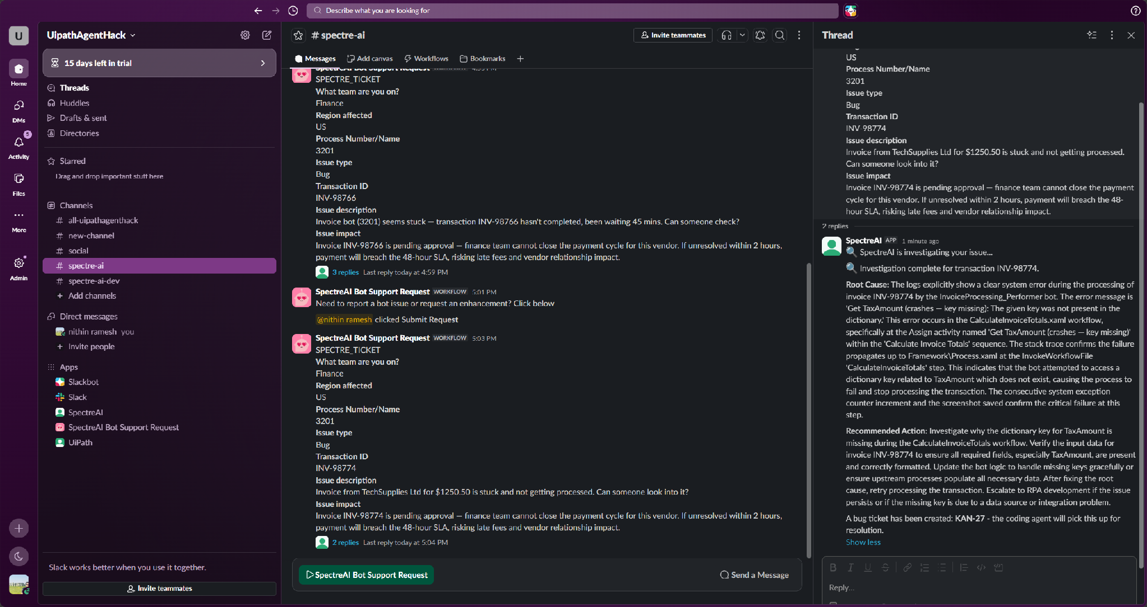
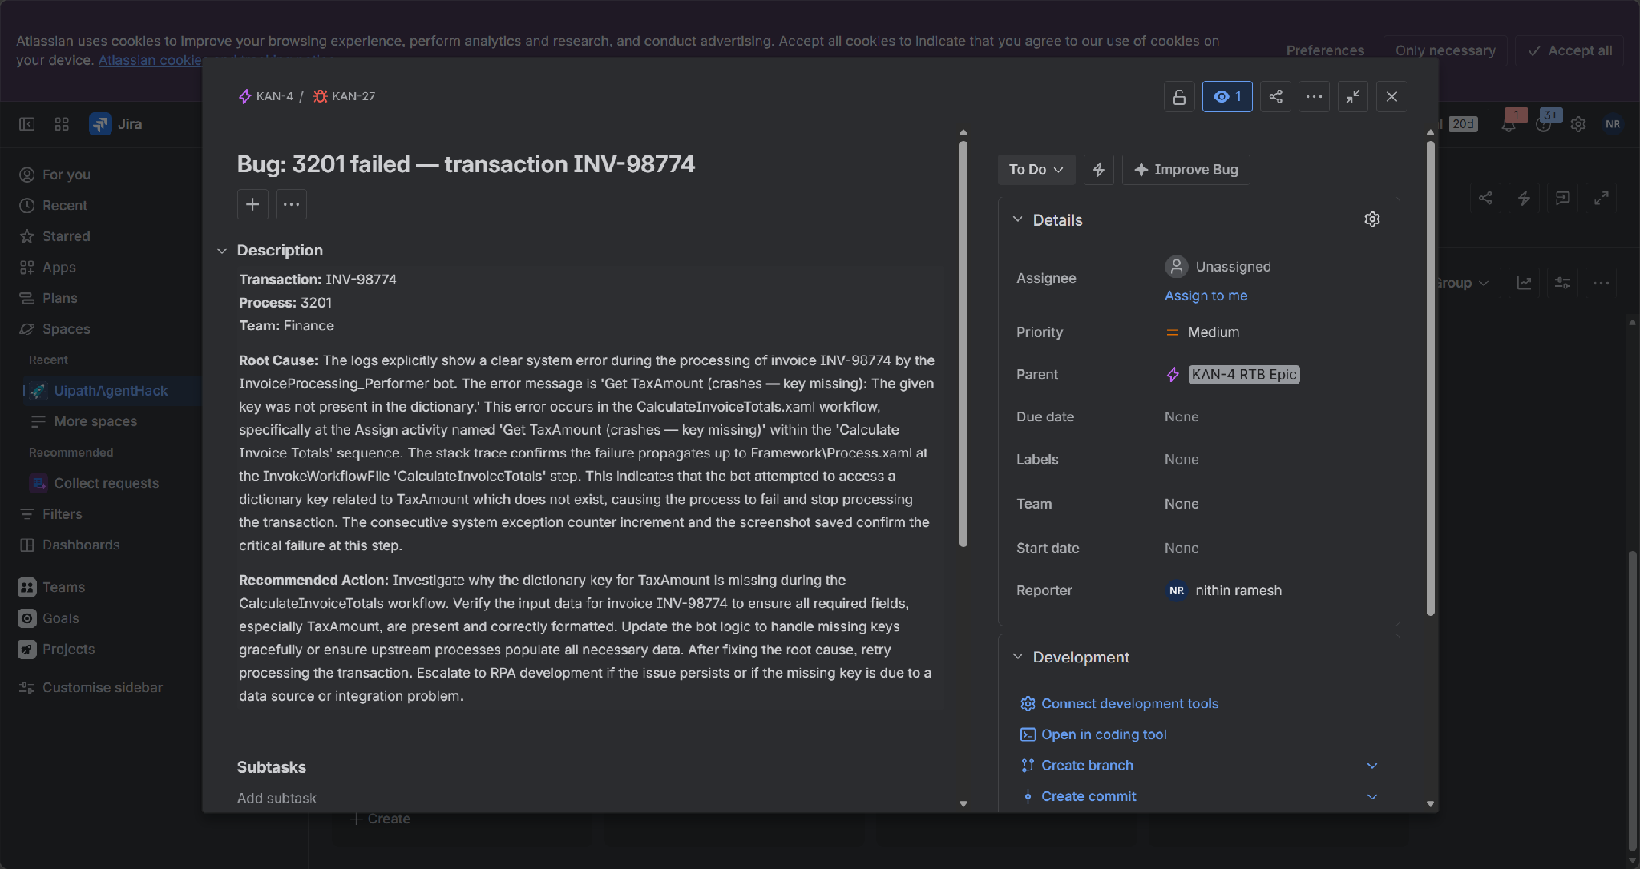
Demo — Happy Path (1/2): Slack Trigger & Investigation
User submits bug via Slack
SpectreAI investigates & diagnoses
Jira bug ticket created

Slide 7
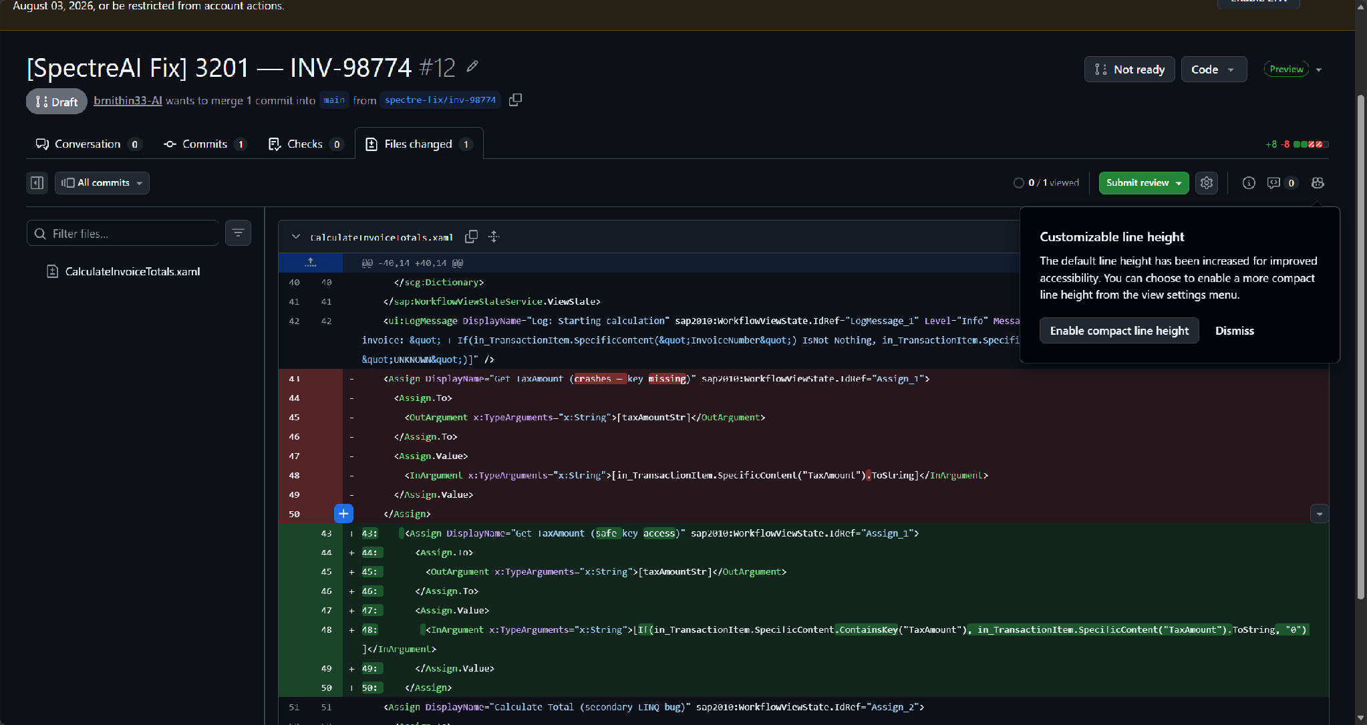
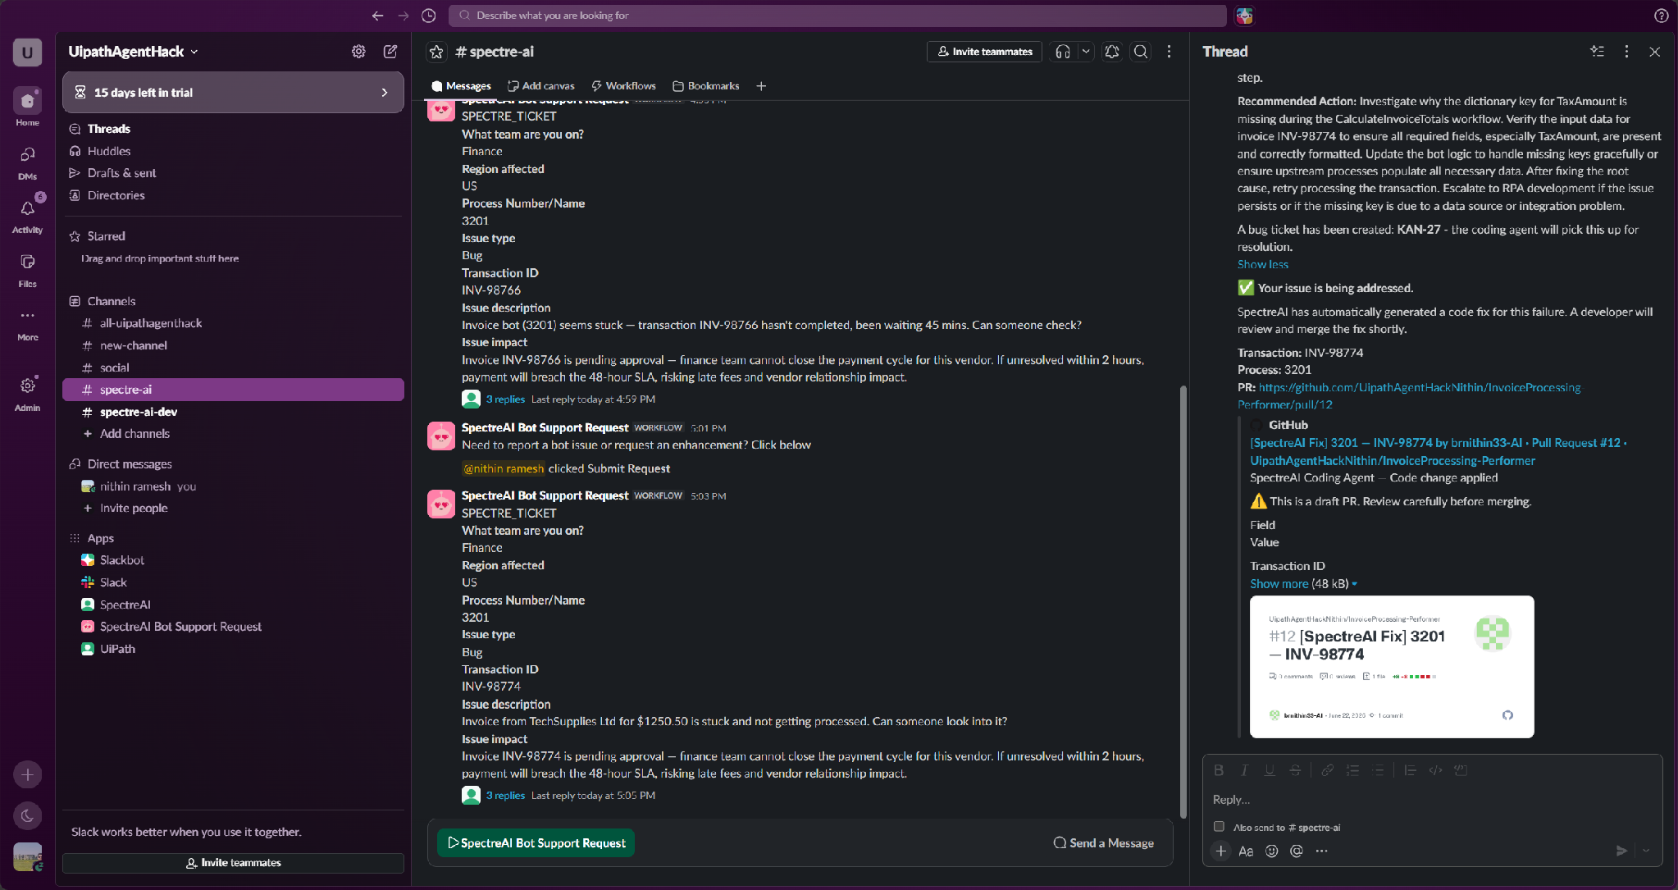
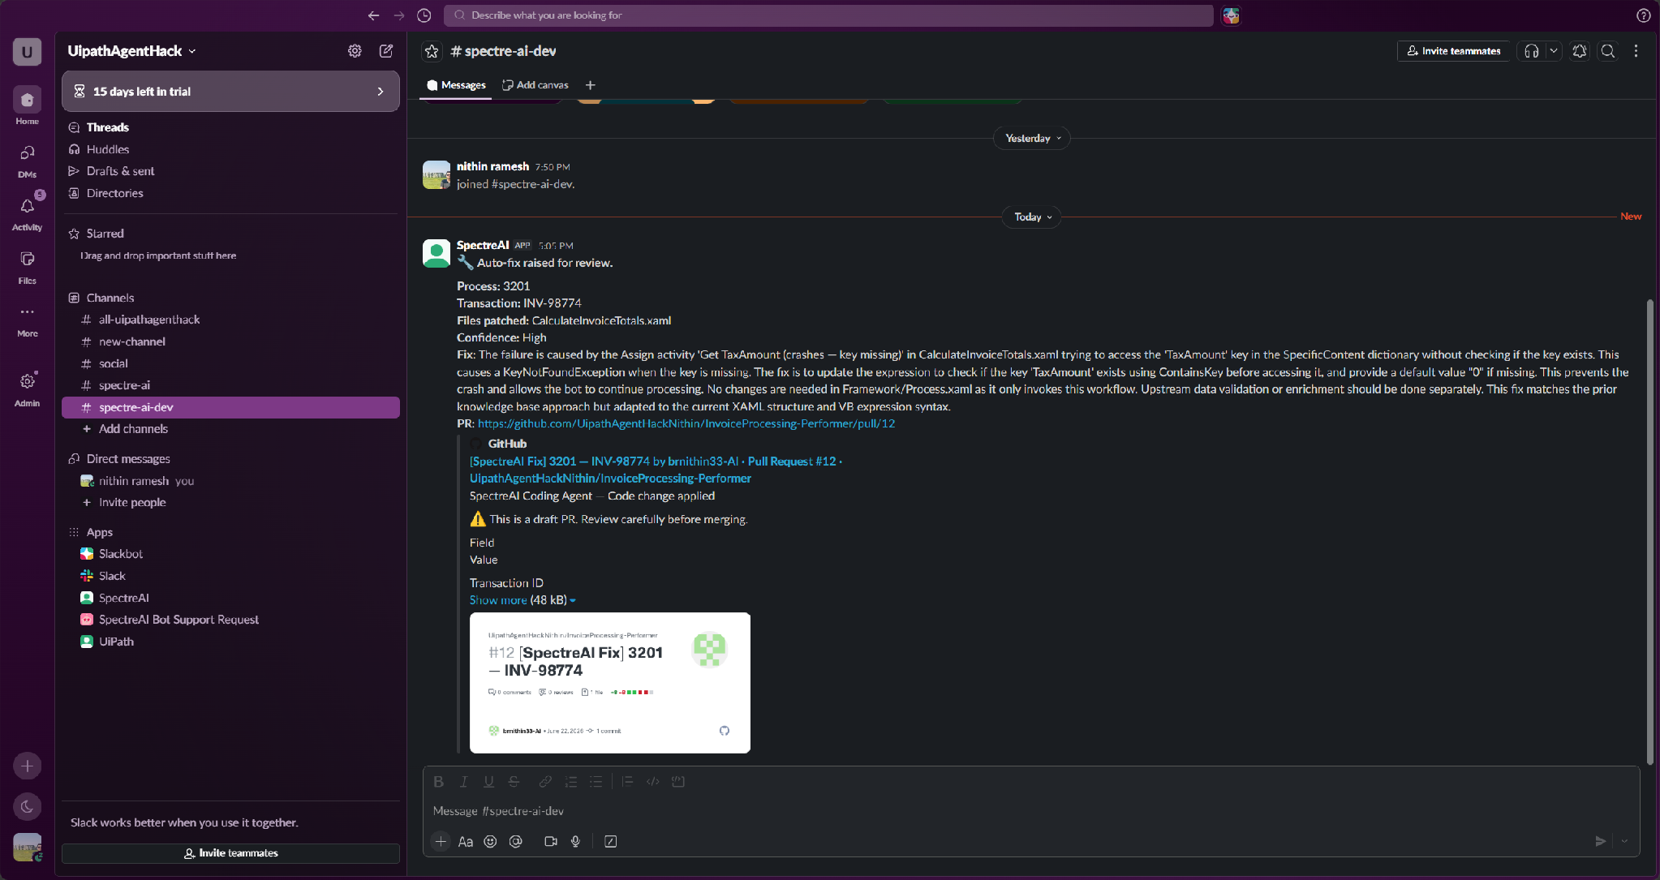
Demo — Happy Path (2/2): Fix, PR & Notifications
Draft PR raised with XAML patch
Support channel notified
Dev channel notified with PR link

Slide 8
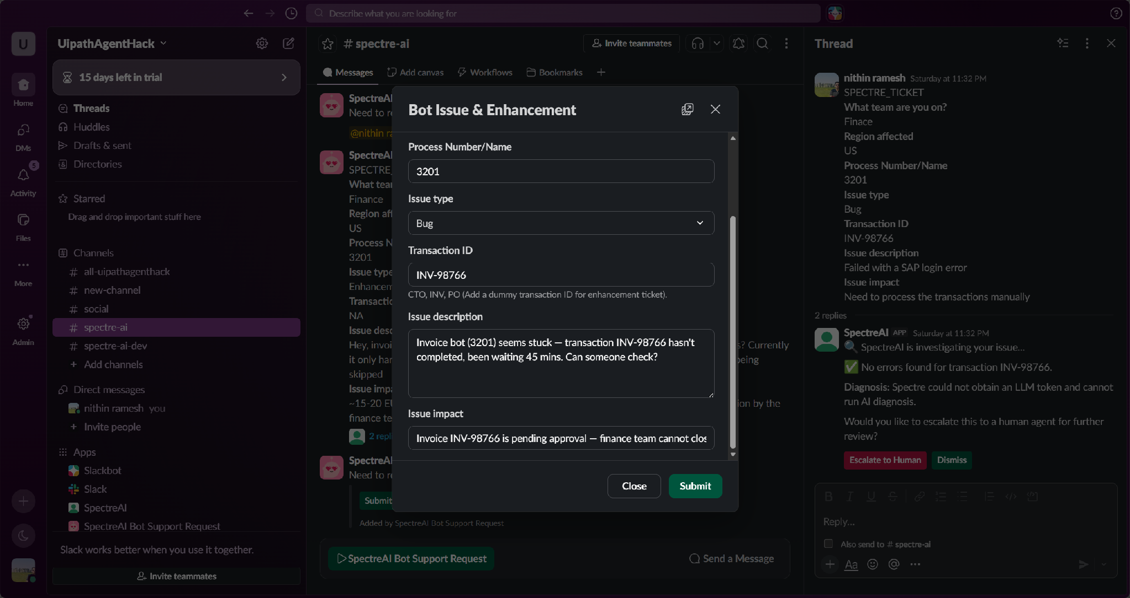
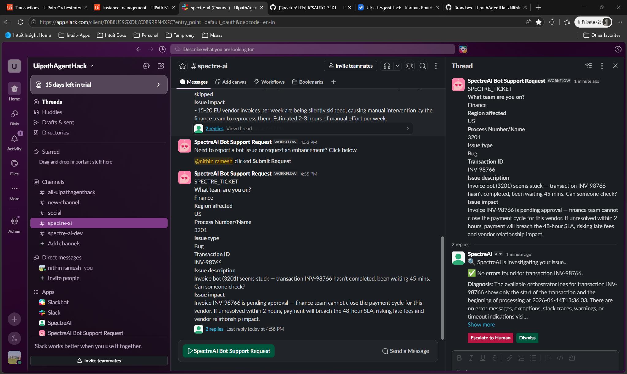
Demo — Escalation Path (1/2): Submission & Mid-Flow
User submits — Transaction with no error
SpectreAI: Escalate or Dismiss?

Slide 9
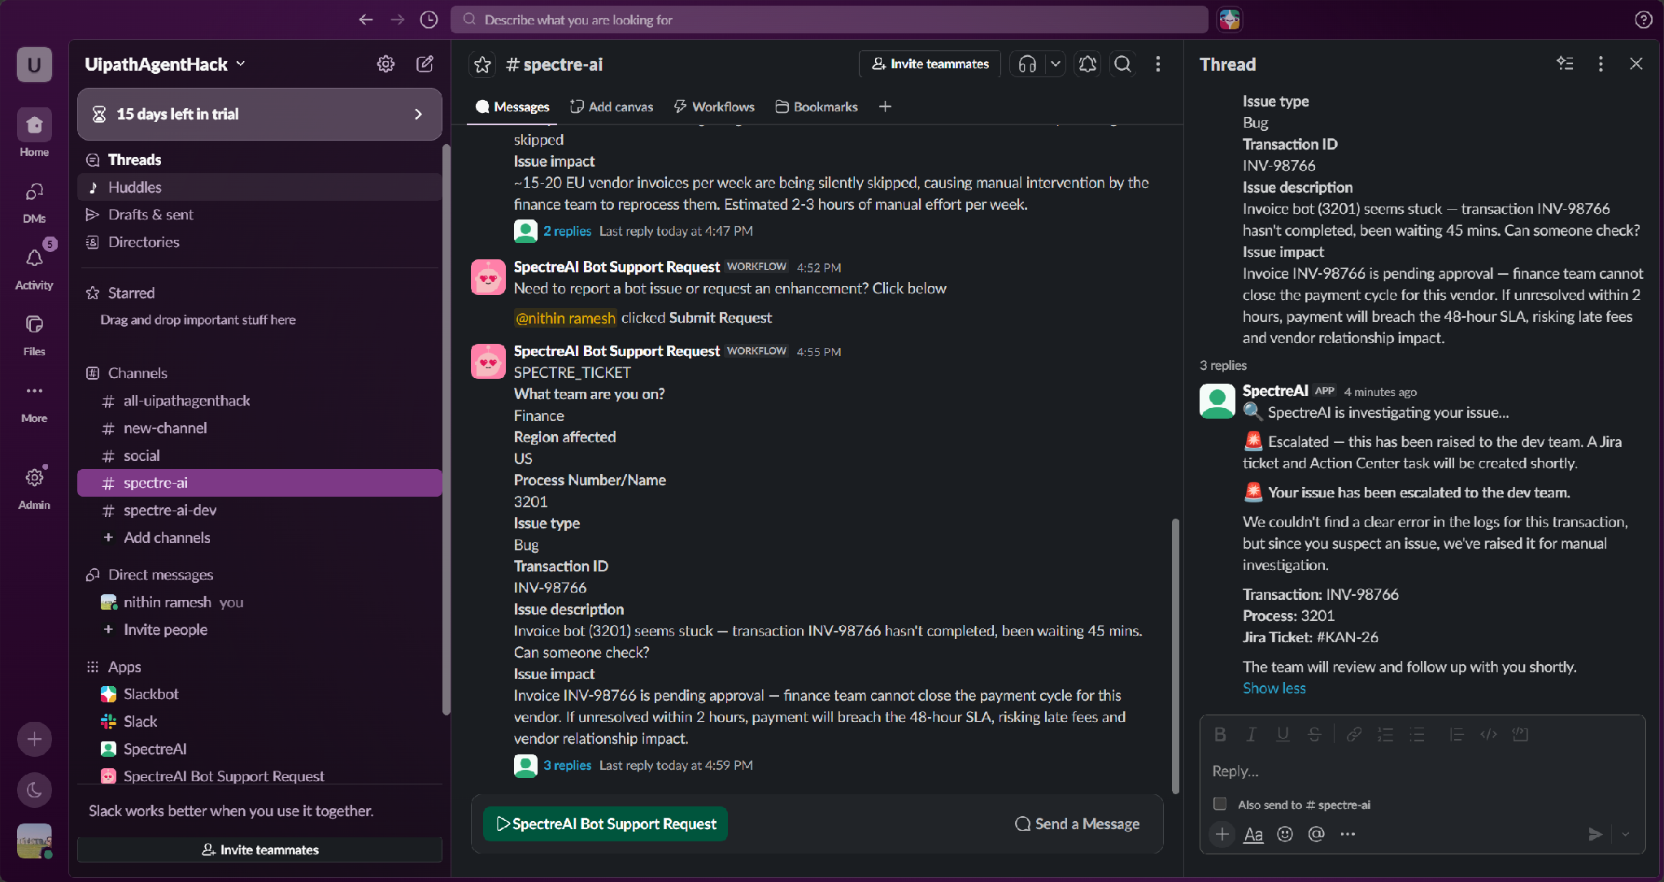
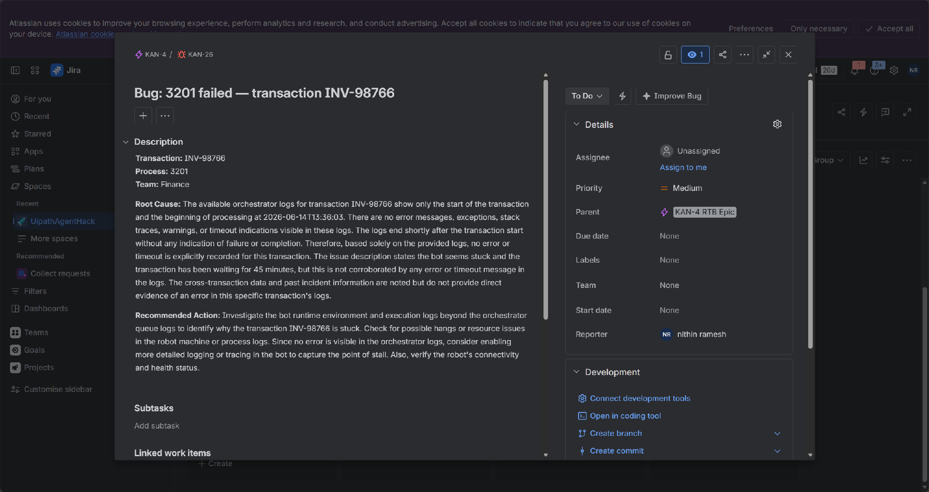
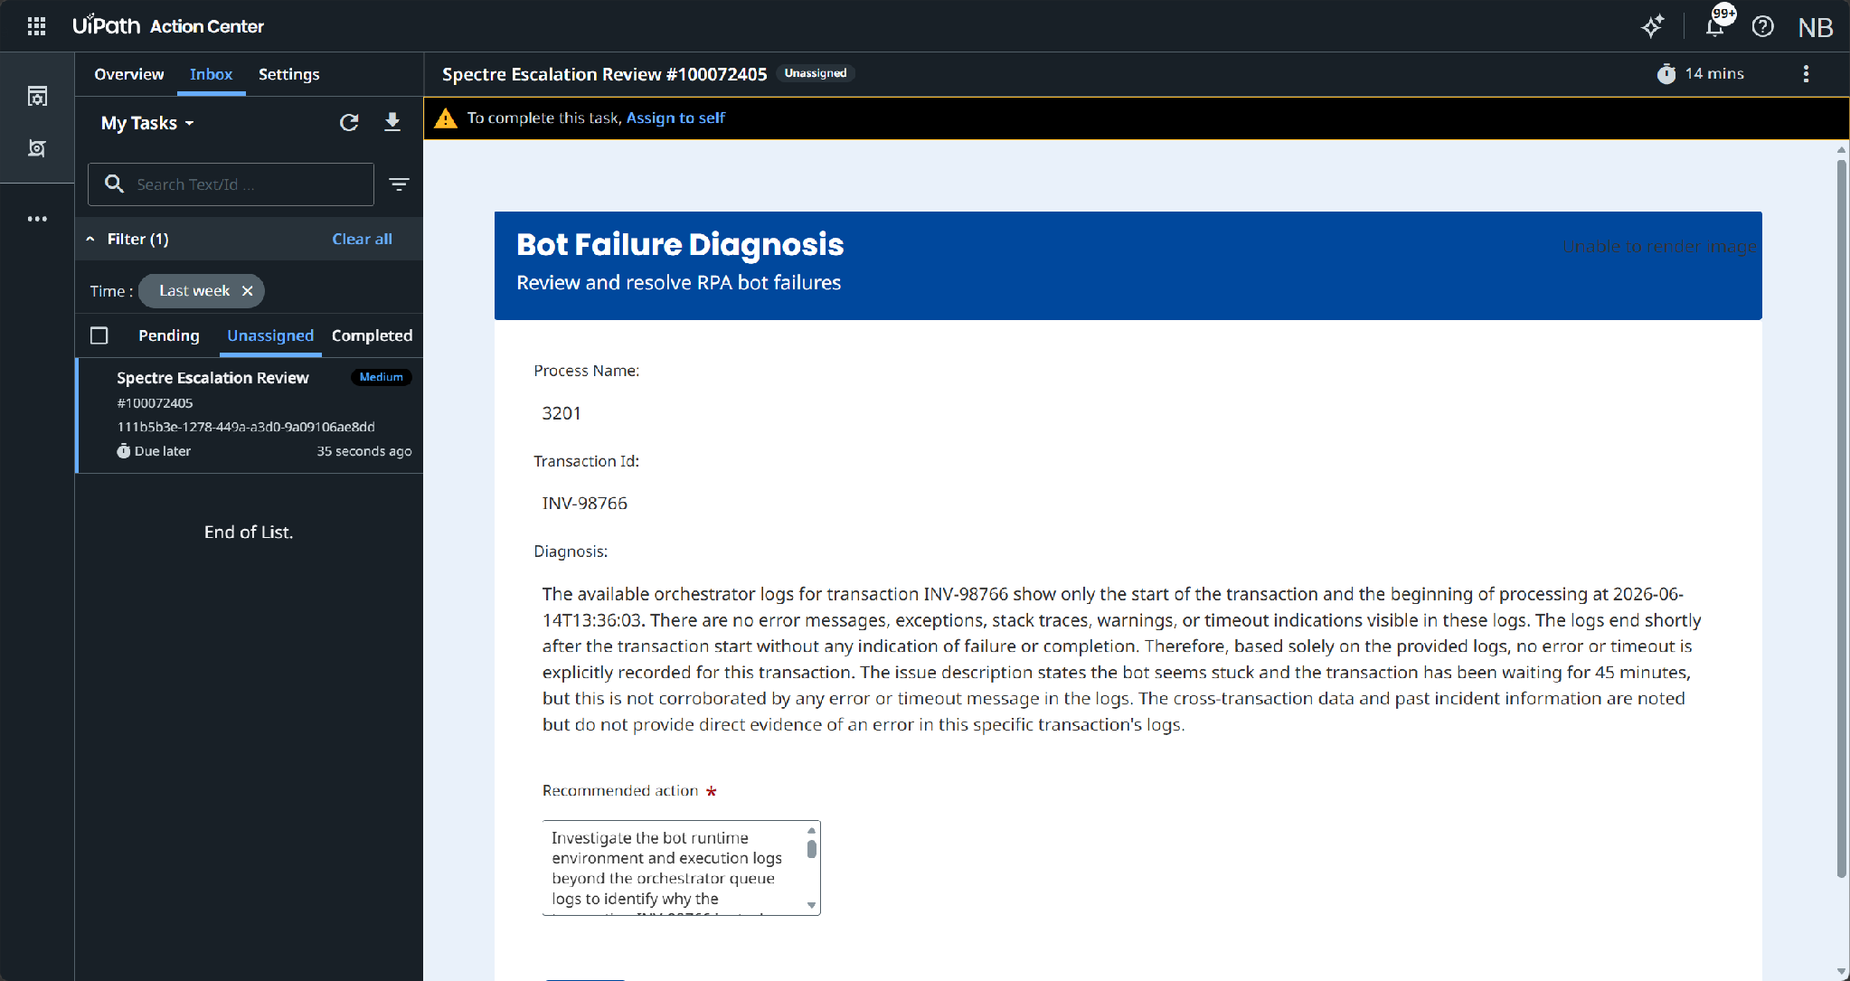
Demo — Escalation Path (2/2): Escalation & Action Centre
Escalation status update
Bug ticket raised
Action Centre ticket for human review

Slide 10
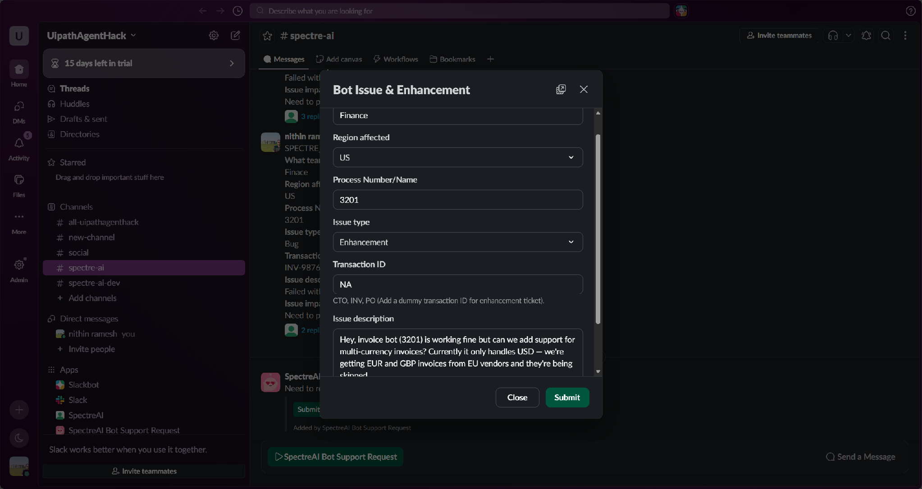
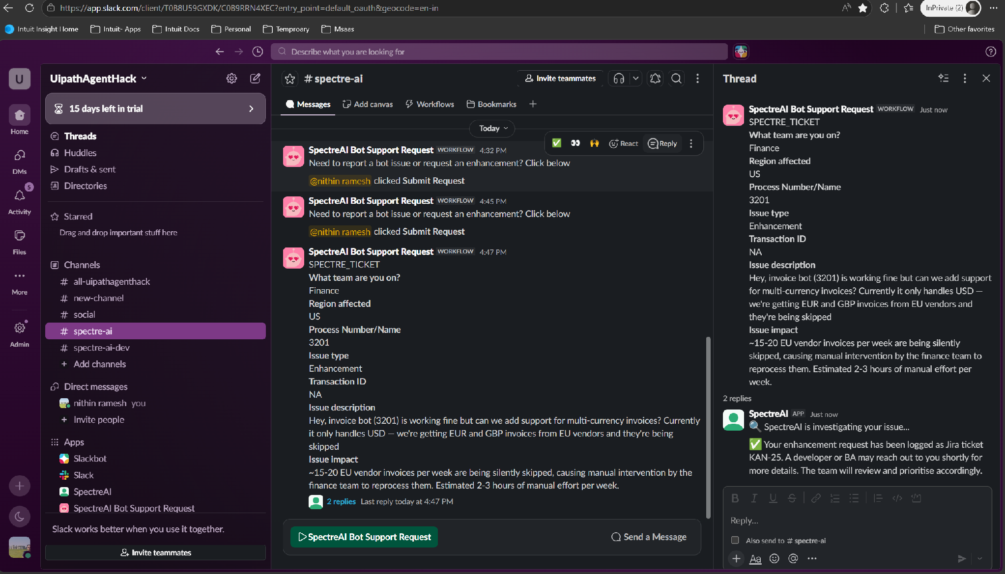
Demo — Enhancement Path (1/2): Request & Acknowledgement
User requests enhancement
SpectreAI acknowledges & routes

Slide 11
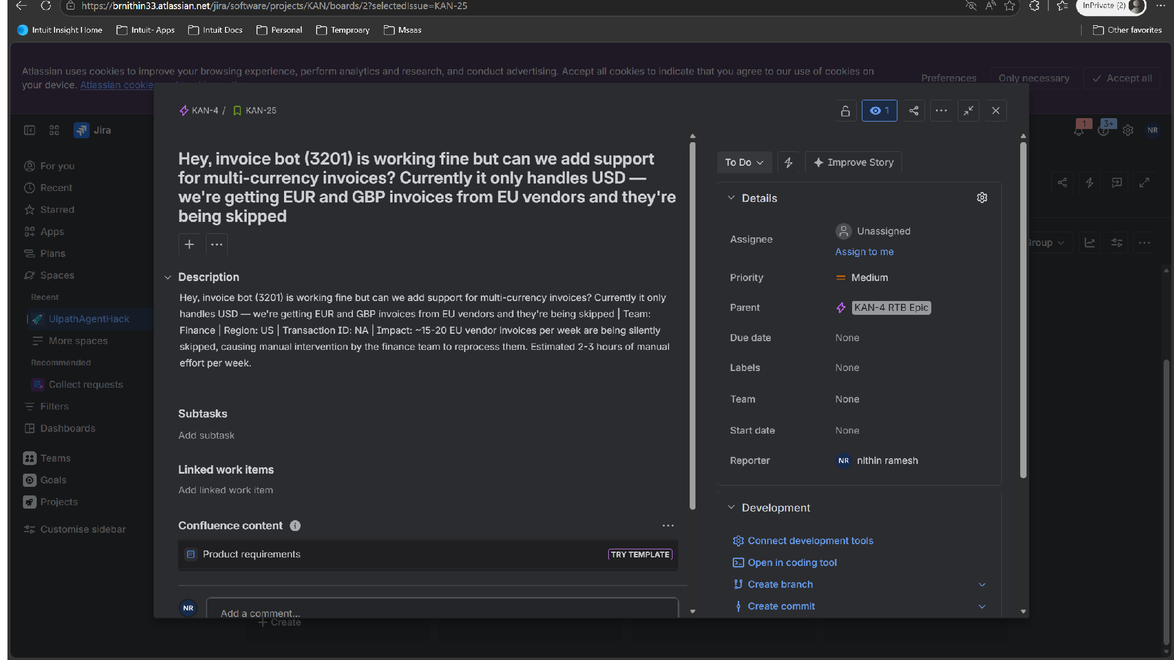
Demo — Enhancement Path (2/2): Jira Ticket Auto-Created
Jira enhancement ticket created

Slide 12
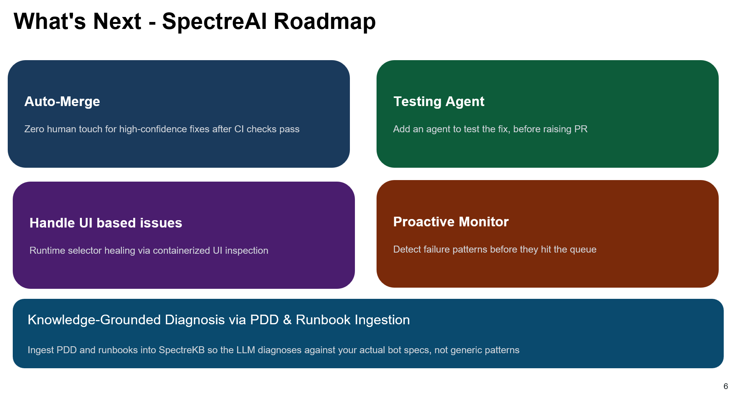

Slide 13
Bot failures resolved. Code committed. Sleep reclaimed.
SpectreAI - because your bots should fix themselves.

